Slide 1

Arduino PWM
Subtítulo
Thainan Santos Theodoro
Universidade Federal de Ouro Preto
João Monlevade, MG
E-mail: thainan.theodoro@ufop.edu.br
Notes:
Agradecimentos: Orientadores, banca interna e externa;
Leitura do Título;
inerge217

Slide 2








O PWM
The Pulse Width Modulation (PWM) is widely used in electronic power to operate converters.
Figure – Typical PWM implementation
Figure – PWM waveforms
$$D$$
$$D$$
$$v_{tri}$$
$$+$$
$$g$$
$$v_{tri}$$
$$−$$
$g$

Slide 3
Arduino PWM: AnalogWrite()
The analogWrite() function on Arduino does not generate a true analog signal, as it lacks a DAC (Digital-to-Analog Converter). Instead, it outputs a PWM (Pulse Width Modulation) signal.
Internal Functioning of analogWrite():
Checks if the pin supports PWM.
Configures the corresponding Timer.
Adjusts the duty cycle using the OCRnX register.
However, Arduino's PWM operates at fixed frequencies of 490 Hz or 980 Hz. It is unsuitable for power converters.
Table - Arduino Uno, Nano, and Pro Mini.
Pins | Timer | Freq.
3, 11 | Timer 2 | 490 Hz
5, 6 | Timer 0 | 980 Hz
9, 10 | Timer 1 | 490 Hz

Slide 4
Arduino PWM
PWM can be generated in a microcontroller using the following elements:
Timer/Counters – Used to track time and define the PWM period.
Comparison Mechanisms – The counter value is compared against a predefined threshold to determine the duty cycle.
Interrupt Service Routine (ISR) – Can be used to update the PWM signal dynamically when a timer reaches a specific value.

Slide 5
Timer/Counters
The Timer/Counter 1 in microcontrollers typically operate in four main modes:
Normal Mode
Clear Timer on Compare Match (CTC) Mode
Phase Correct PWM Mode
Phase and Frequency Correct PWM Mode

Slide 6
Normal Mode
The timer counts up until it overflows and resets to zero.
No automatic waveform generation.
Often used for time delays with interrupts.
Table – Technical Characteristics.
Figure – Counter.
Timer | Bit Resolution | Counting Range
Timer 0 | 8-bit | 0 to 255 (0x00 to 0xFF)
Timer 1 | 16-bit | 0 to 65,535 (0x0000 to 0xFFFF)
Timer 2 | 8-bit | 0 to 255 (0x00 to 0xFF)

Slide 7
Clear Timer on Compare Match (CTC) Mode
In CTC, the timer counts up until it reaches a predefined compare value stored in the OCRnA or ICR1 (depending on mode).
ICR1’
ICR1’’’
ICR1’’

Slide 8
Fast PWM Mode
The timer counts from 0 to a predefined TOP value (e.g., ICR1), then resets, generating a sawtooth waveform. For example, the OCR1A sets the duty cycle, and OC1A outputs the PWM signal.
Figure – Fast PWM Mode
ICR1
COUNT
The updates of ICR1 and OCR1A are made at the BOTTOM of counter.
OCR1A
200
OC1A

Slide 9
Fast PWM Mode
D variation
Freq. variation
1600
1600
ICR1
ICR1
800
OCRA1
900
OCRA1
400
400
OCRA1’
OCRA1’
COUNT
COUNT
400
OC1A
OC1A

Slide 10
Phase Correct PWM Mode
The timer is up/down using predefined TOP value (e.g., ICR1), generating a triangular waveform. For example, the OCR1A sets the duty cycle, and OC1A outputs the PWM signal.
Figure – Phase Correct PWM Mode
ICR1
COUNT
The updates of ICR1 and OCR1A are made at the TOP of counter.
OCR1A
200
OC1A

Slide 11
Phase Correct PWM Mode
D variation
TOP (ICR1) variation
ICR1
1600
1600
1600
ICR1
800
OCRA1
900
OCRA1
400
400
OCRA1’
OCRA1’
COUNT
COUNT
OC1A
OC1A

Slide 12
Phase and Frequency Correct PWM Mode
The timer is up/down using predefined TOP value (e.g., ICR1), generating a triangular waveform. For example, the OCR1A sets the duty cycle, and OC1A outputs the PWM signal.
Figure – Phase and Frequency Correct PWM Mode
ICR1
COUNT
The updates of ICR1 and OCR1A are made at the BOTTOM of counter.
OCR1A
200
OC1A

Slide 13
Phase and Frequency Correct PWM Mode
D Variation
TOP (ICR1) variation
1600
1600
1600
ICR1
ICR1
800
OCRA1
900
OCRA1
400
400
OCRA1’
OCRA1’
COUNT
COUNT
OC1A
OC1A

Slide 14
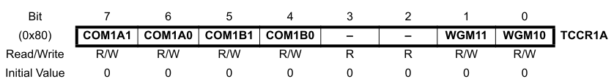
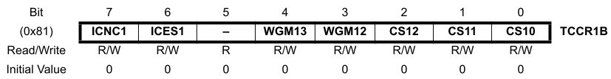
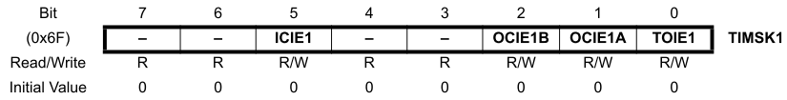
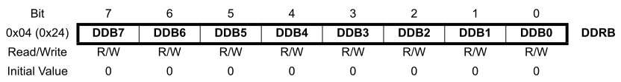
Fast PWM Mode
Set registers
TCCR1A
TCCR1B
TIMSK1
DDRB
Set values
ICR1
OCR1A

Slide 15
Fast PWM Mode
Registers TCCR1A and TCCR1B
Clock Select/prescaler (TCCR1B):
CS12, CS11, CS10.
Waveform Generation Mode Bit (TCCR1A and TCCR1B):
WGM13, WGM12, WGM11, WGM10.
Inverting and non-inverting, Fast PWM (TCCR1A):
COM1A1, COM1A0, COM1B1, COM1B0.
Register TIMSK1
Enable interruptions: overflow / match
Register DDRB

Slide 16

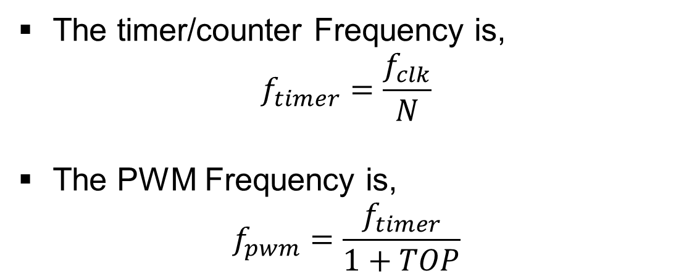
Frequency
Bit Masking is a technique used to manipulate specific bits within a register without altering the others.
TOP
The timer/counter Frequency is,
$$f_{timer}=\frac{f_{clk}}{N}$$
The PWM Frequency is,
$$f_{pwm}=\frac{f_{timer}}{1+TOP}$$
OCR1A
OC1A
$$T_{PWM}$$

Slide 17
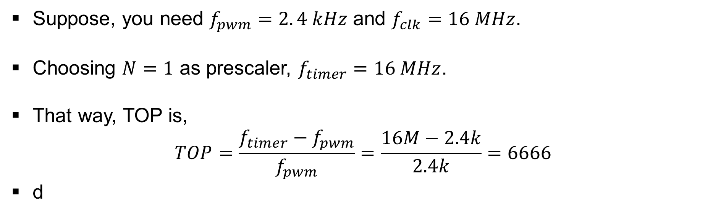
Example
Suppose, you need $f_{pwm}=2. 4 kHz$ and $f_{clk}=16 MHz$.
Choosing $N=1$ as prescaler, $f_{timer}=16 MHz$.
That way, TOP is,
$$TOP=\frac{f_{timer}−f_{pwm}}{f_{pwm}}=\frac{16M−2.4k}{2.4k}=6666$$
d

Slide 18
Bit masking
Bit Masking is a technique used to manipulate specific bits within a register without altering the others.
REGISTER |= (1 << BIT);
Enable a bit (set to 1)
REGISTER &=~(1 << BIT);
Disable a bit (set to 0)
Keeps the other bits unchanged.
Uses bitwise OR (|=).
Keeps the other bits unchanged.
Uses bitwise AND (&=) and NOT (~).

Slide 19
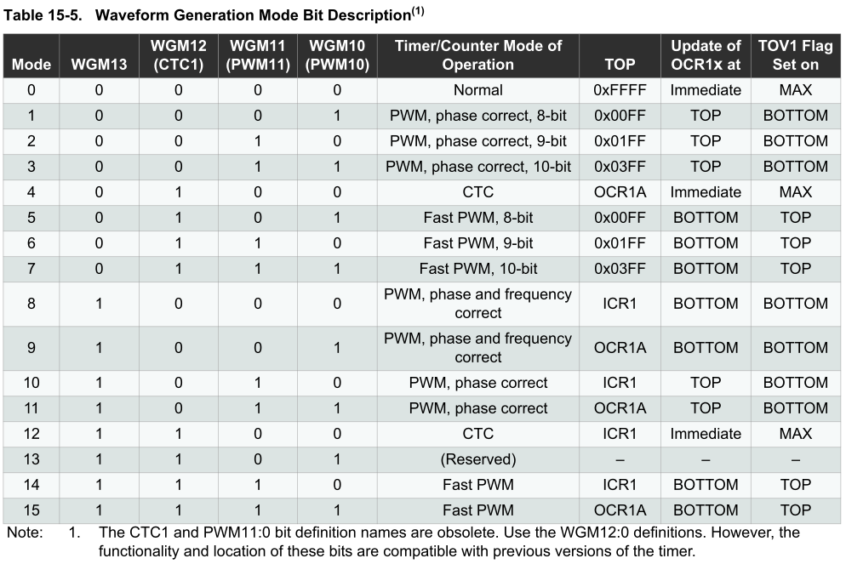
Fast PWM Mode

Slide 20
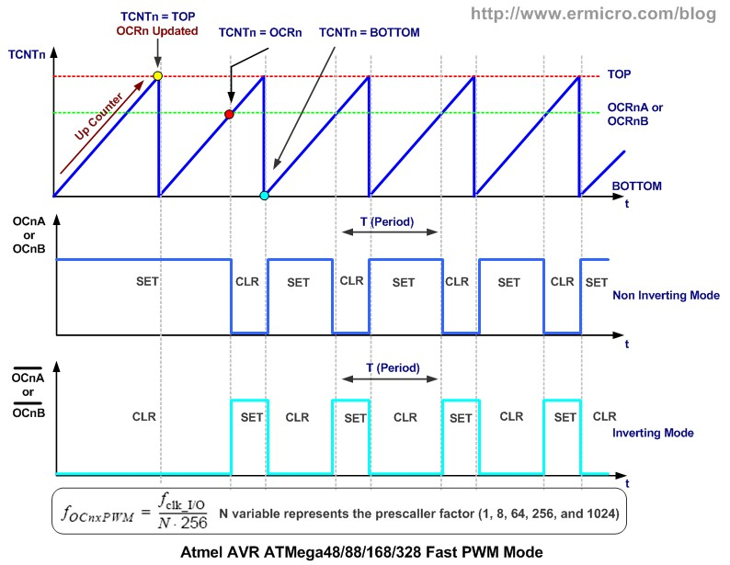
Inverting and non-inverting modes

Slide 21
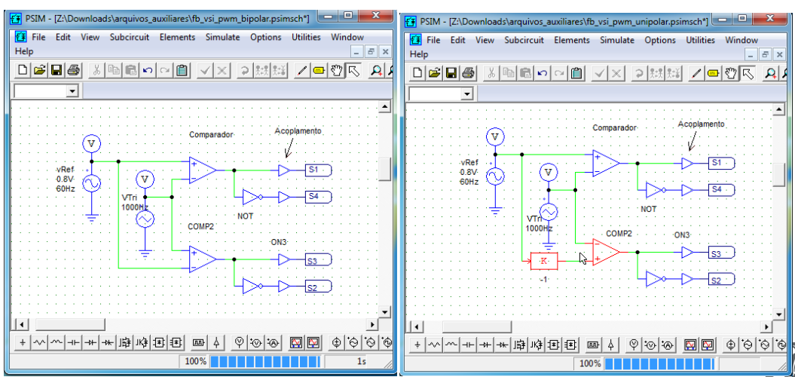
Inverting and non-inverting modes

